Slide 1
Words of Worship
Operator Training Session
Copyright © 2002-2006 NobleTech Products
All rights reserved
Copying, distribution or unauthorised linking is not permitted

Slide 2
Operator Training Session
Main features of Words of Worship
Tasks required during a session
Professional usage hints and tips
Practical session
Customisation and advanced features

Slide 3
Main Features
Display songs
Control PowerPoint
Display bible passages
Advanced song search
Multi-monitor system

Slide 4
Session Tasks
Select songs to create playlist
Navigate within / between songs
Add spontaneous songs
Blank during silence / improvisation
Show urgent alerts
Add a new song

Slide 5
Select Songs
Use the Quick Pick window
  Search or First Line
Insert separators
Use the folders drop down for bible
  Type references as normal
  No book abbreviations
  Otherwise use [All Folders]

Slide 6
Navigation During Display
Go to next line
Go to a different block
  Go to numbered verse
  Go to chorus
  Go to bridge
Go to next item (usually next song)

Slide 7
Advanced Navigation
Go to song not next in list
  Go to previous song
  Repeatedly go to next song while blanked
  Use Quick Pick window to type song name
Go to next page
  Prevents scrolling for read items
Go to next block
  Can be used as an alternative
  Is not so easy to quickly correct

Slide 8
Add Spontaneous Songs
Don’t panic!
Blank the screen
Go to the quick pick
Search for the song
Default actions will bring the song up

Slide 9
Show Urgent Alerts
To put up an urgent notice
Go to the alert bar (Ctrl+A)
Type the (short) notice
Click Show or press Alt+S
The notice will appear over songs
The notice will disappear automatically

Slide 10
Add Songs
Click the File menu and then click New
Select the type of item to create
Type in the words and mark the chorus
Click the Insert menu and then click Into Playlist
Save in the all songs folder

Slide 11
Professional Usage
General navigation tips
Avoid using the mouse
Be confident and think about timing
Memorise the ten main keys
Remember the Esc key

Slide 12
Navigation Tips
In general, do not:
Go to previous line
  Scrolling up looks confusing
  To repeat a block, select it as before
Select from playlist
  Almost always quicker to use Quick Pick
  Quick Pick uses the item in the playlist if it’s already there

Slide 13
Mice are Dirty
The mouse is very intuitive
But it is ALWAYS slower
There are not many keys that you need to know
If you possibly can, bin your mouse once the service starts

Slide 14
Timing
Getting the wrong verse will embarrass you once
Being slow will embarrass newcomers continually
Switch line at the start of the last word
Switch block at the end of the last word
Get to know the songs

Slide 15
Keys for Words of Worship
All other keys can be looked up using menus
Go to Quick Pick – Ctrl+Q
Insert Item - Enter
Blank Screen – Esc
Start service – Shift+F5
Next Line – Down
Verse – [Verse no.]
Chorus – C
Bridge – B
Next Item –
Ctrl+Pg Dn
Previous Item – Ctrl+Pg Up
Next Page – Pg Dn

Slide 16
Esc is your friend
If in trouble, hit Esc
The output will be blank
The congregation will forgive you

Slide 17
Practical session
Time to put it into practice…

Slide 18
Customisation
Search all lyrics or just first line
Setting up for a new venue

Slide 19
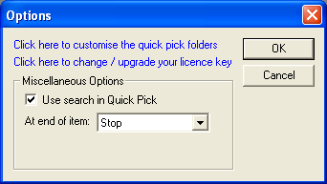
To Search or not to Search
Options Dialogue
  View menu
  Options command
Use search in Quick Pick
  First line gives ease of playlist entry
  Search gives ease of spontaneous song entry
Override per use

Slide 20
Venue Tasks
Before first use you need to
Select visible area to match screen
Select font size to be visible at back
Leave other settings as they are
Font colour, etc will already be set up

Slide 21
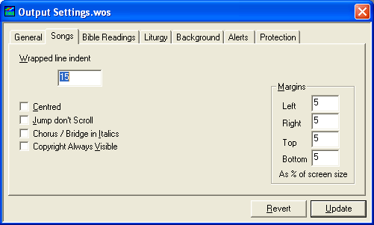
Venue Output Settings
Output Settings
  Display menu
  Output Settings… command
General tab
  Set font size
Songs tab
  Set visible area
Bible Readings tab
  Usually full screen

